Slide 1


AFRICAN NETWORK
OF ADOLESCENTS
AND YOUNG PERSONS
DEVELOPMENT - (ANAYD)

Slide 2
PROFILE
African network of adolescent and young person's development (ANAYD) is a regional organization working for and with adolescents and young people in their diversities which include ( adolescents girls and young women (AGYW), adolescents and young people living with HIV (AYPLHIV), young key populations (YKPs) and young people living with disabilities (YPLWD)) both infected or affected with HIV, Tuberculosis and Malaria. It was form 2015 in Nigeria, but properly inaugurated on 29th September 2017. It is established and saddled with the responsibility to facilitate the provision of "Educational Development", " Digital and Socio-Economic Development", "Treatment, Care and Support services to adolescents and young people; to equip them with adequate capacity and skills and information on HIV, Tuberculosis, Malaria, sexual, reproductive health and rights (SRHR) so as to prevent further spread of HIV, Tuberculosis, STI and other related Health disease among adolescents and young people, and the general population. We strive to promote adolescents and young people’s access to services in a manner that is youth friendly and of good quality. ANAYD is still growing and involving significantly against all odds. besides that it has it officials, and today ANAYD is part of the success story in fight against HIV/AIDS, SRHR,GBV and other related health cases among adolescent and young people in Nigeria and Africa.

Slide 3

Vision
Mission
To see an Africa where the rights, welfare and interests of adolescents and young people in their diversities are assured and protected, and the larger society is protected from the spread of health related diseases.
To lead the effort of mitigating the physical, psychosocial and economic impact of HIV, Tuberculosis, Malaria and other health related infections among adolescents and young people in their diversities through information sharing, education, advocacy, capacity building and economic empowerment.

Slide 4

Goals
Objectives
To ensure greater and meaning involvement of adolescents and young people in their diversities in policy formulation, decision making, governance, program design, development, implementations, monitoring and evaluation at all levels.
To promote fundamental human rights and gender equality of adolescent and young people in their diversities.
To promote comprehensive sexual reproductive health and right information and services for adolescent and young people in their diversities.
To facilitate access to free and comprehensive prevention, treatment, care and support for adolescent and young people in their diversities.
To provide and sustain a platform for adolescents and young people in their diversities to come together, exchange ideas through the instrument of peer support groups and forums.
To facilitate meaningful involvement of adolescent and young people in their diversities in program design, development, implementations, monitoring and evaluation at all levels.
To facilitate access to social economic support for adolescents and young people in their diversities in the country and Africa.
To foster synergize and build positive partner relation and collaboration with other national, regional and global stakeholders, NGOs, CSOs and networks for effective programming and resource mobilization for adolescents and young people in their diversities.

Slide 5

Geographical Coverage and Network Membership
Board Of Trustees
ANAYD is a non-discriminatory organization with over 87 NGOs, CSOs, Networks and CBOs who subscribe to it in Kaduna state, over 90 NGOs, CSOs, CBOs, and networks who subscribe across 37 states of Nigeria and 7 west and central African NGOs, and Networks who subscribe. ANAYD operate across 6 geopolitical zones in 10 states; Abia Akwa Ibom, Anambra, Lagos, Benue, Kaduna, Abuja, Kwara, Kano and Taraba). But currently through Global Fund grant worked across 7 states namely (Akwa Ibom, Anambra, Lagos, Benue, Kaduna, Abuja and Taraba).
ANAYD also have professional individuals such as medical doctors, clinicians, advocates, activist, media, academia, researchers, lab scientist, and community members (KPs and LGBTQ) who subscribe personally and are committed to the goals and objectives of the organization.
ANAYD is registered as a civil society organization and made up of three board members who were appointed from different works of life; professionals and public health consultants at high positions in the Nigerian and International HIV and SRHR responses.

Slide 6
Advisory Board Members
Program Management Team
The advisory board members of the organization compose of professional independent individuals who have serve or are still serving across government agencies, implementing partners, donor agency, private sectors and political law makers who upon request call by the organization to serve in such capacity when accepted; and adolescents and young people who serve to voice and share current issues as it face them towards also guiding the organization program approach in line with current needs. they all provide guidance and share expertise towards helping the organization growth and strengthen visibility.
The projects and activities of the organization funded by partners and donor agencies is been management, and supervise by the program management team of ANAYD. The team is made up of 7 young people who are professionals, vibrant intellectuals and creative to cause the change young people would love to see in our time. ANAYD also have 9 program officers working as it state actors and focal point across 10 states namely (Abia, Akwa Ibom, Anambra, Lagos, Benue, Kaduna, Abuja, Kwara, Kano and Taraba), And over 490 pool volunteers it works with for most of its projects or activities and which some are professional individuals with Masters, Bsc, NCE, Diploma, SSCE and other professional qualifications.

Slide 7
Legality
Structure
ANAYD was established in October 25th 2015, inaugurate 29th September 2017 and was fully registered with the Corporate Affairs Commission (C.A.C) in Nigeria and Abuja as a civil society organization and an incorporated charity body on July 30th, 2019 with CAC/IT/NO: 133047 registered number and also haven pass through the Economical and Financial Crimes Commission (EFCC) Nigeria-Special Control Unit Against Money Laundering (SCULM) the organization on the 11th September 2019 was duly registered in accordance with the provision of section 5 (1) (a) and (4) of the Money Laundering (Prohibition) Act, 2011, Tax Identification Number (TIN): 21454235.
The Headquarter is based in Nigeria No 39A Kujama Close, Barnawa, Kaduna State, Nigeria and has a complete management and governance structure. The organization has a management board that over sees its affairs across the state as well other locations within the country. We also have a work space for our technical tasks at ,3rd Floor, Wing D, Community Park: Bassan Plaza, Plot 759, Central Bussiness District Abuja , Block 7, Beside Number One Hotel, By SS Peter and Paul Catholic Church, Nyanya Abuja. , AYDEC office No 12, Cape town Street, Wuse Zone 4, 2nd Floor Suite 205B, FCT Abuja, No 10, Modele Compound, Off Teiuosho Rd, Barracks Bus Stop, Surulere, Lagos State, Nigeria and No 14, Gbeleyi Street Ogba Ikeja Lagos Nigeria.

Slide 8
Core Values
Target Population
Our Thematic Areas
Commitment, Hardworking, Team Spirit, Professionalism, Accountability, Honesty, Transparency, Trustworthy, Loyalty.
- Pediatric
- Adolescents and Young People
- Adolescent Girls and Young Women
- Adolescents Living with HIV, TB
- Adolescents and young Key Populations (MSM,FSW,PWID&LGBTQI)
- Adolescents Living with Disabilities.
HUMAN RIGHTS
HUMANITARIAN RESPONSE
GOVERNANCE AND POLICY
HEALTH
SOCIO-ECONOMIC EMPOWERMENT
EDUCATION
ENTERTAINMENT
GENDER
INFORMATION AND COMMUNICATION TECHNOLOGY(ICT)

Slide 9
Core Strategy
Demand creation
Peer education
Platform settings (Peer support group and forums)
Community dialogue
Advocacy
Capacity building
Data hub
Research
Consultancy
Volunteerism
Mentorship
Social Media
Partnership

Slide 10
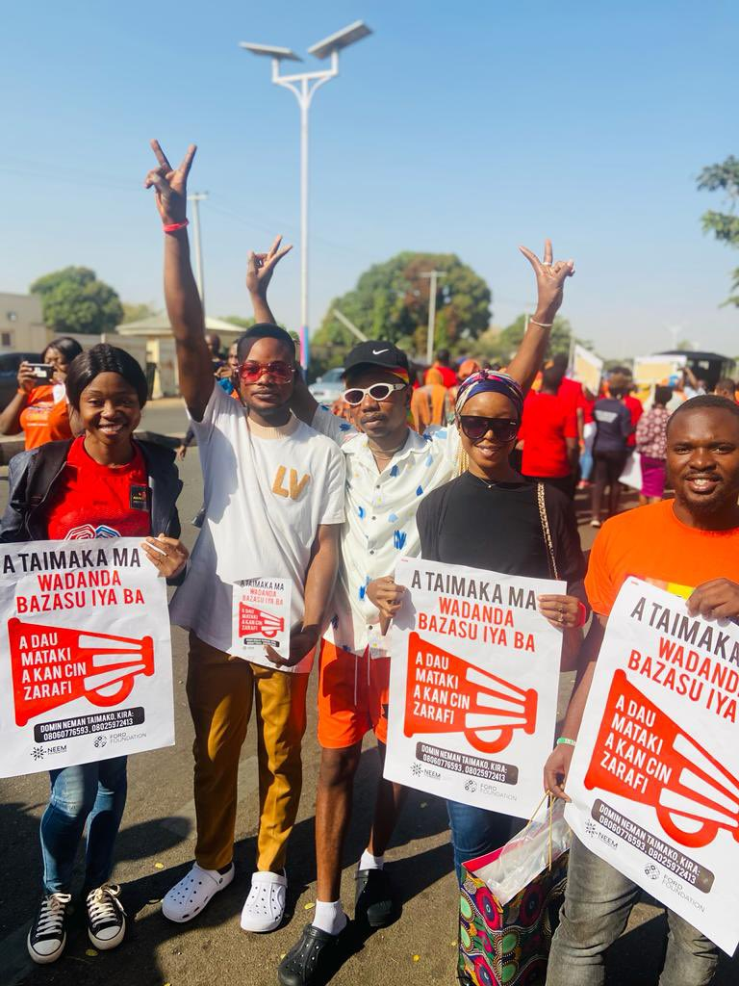
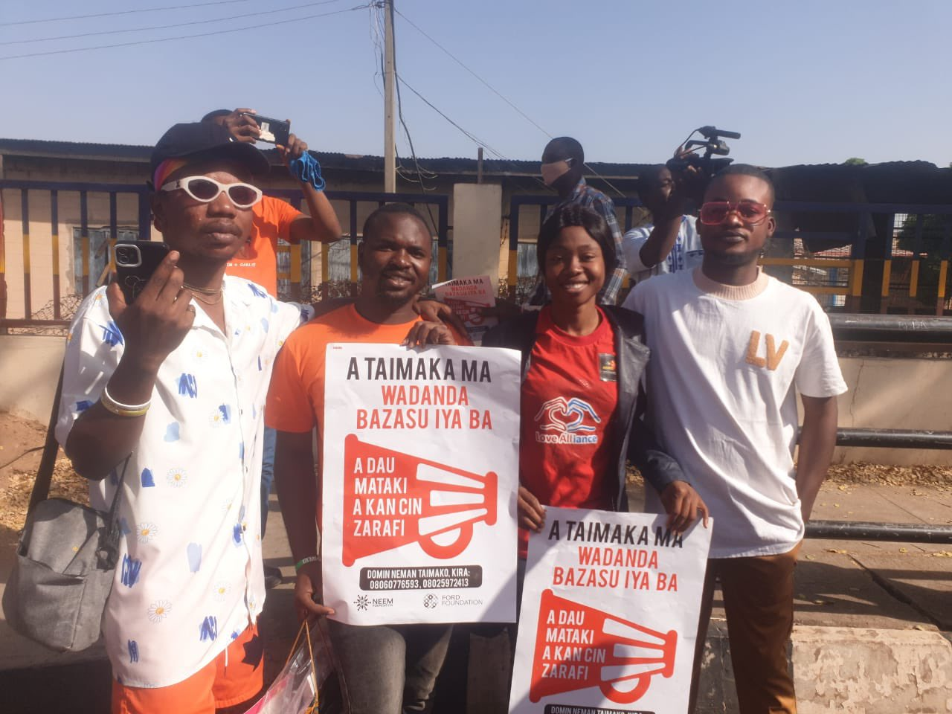
PICS: @anayd_africa partook in the Healthy Road Walk to the Kaduna State Government house in commemoration of the #16DaysofActivism2022.

Slide 11
GROUP 1
TARGET GROUP Pediatric (0-9) (10-19) ADOLESCENT WITH HIV,TB
NEEDS | INTERVENTION
Parents to child disclosure | Parent-children support group Counseling Parent-child peer mentoring
Educational/Nutrition support | Sensitization of head or owners of school to prevent stigma/discrimination of a child living with HIV Counseling of the parent on good hygiene/balance diet
Quality service | Capacity building for Health service providers on Youth friendly services. Capacity building for health service providers on pediatric services. Capacity building for health service providers on updated guidelines for pediatric support service. Establish forum and platform for health service providers for knowledge sharing and synergy.

Slide 12
(10-19yr) ADOLESCENT WITH HIV,TB
Parents to adolescents disclosure | Adolescents peer support group Counseling Peer to peer mentoring
Educational/Nutrition support | Sensitization of head or owners of school to prevent stigma/discrimination of adolescents living with HIV Counseling of adolescents on good hygiene/balance diet
Sex reproductive health services | Conduct sensitization and comprehensive reproductive health/services
Family planning service | Conduct training/sensitization of family planning

Slide 13
Legal rights and protection | advocacy to stakeholders and communities gatekeepers against stigma and discrimination
 | Partnering with NGOS focused on human right protection.
 | Advocate for the passing into law bills and policies that protect the right of the target population.
Association and relationship skills. | Training on association and human interaction skills for YPLHIV.
Protection from consequences of sex. | sensitization on the right of PLs to caregivers, community members and YPLHIV.
 | Emergency response provision and humanitarian support (comm. based)
Economic empowerment | Skills acquisition project.
Prevention to new infection | PHDP-position Health dignity and prevention.

Slide 14
GROUP 2
TARGET GROUP YOUNG PEOPLE (20-24) LIVING WITH HIV,TB.
NEEDS | INTERVENTION
Life building skill | Training on problem solving skills and building of self esteem
Sex reproductive health services | Conduct sensitization and comprehensive reproductive health/services
Family planning service | Conduct training/sensitization of family planning
Income generation introduction | Training on skills acquisition
Forming a right decision in a relationship | Assertiveness training/guidance and counseling
Basic right protection | Courtesy visits to law makers/Gov. to ensure enactment of HIV workplace policy
Career decision making | Engagement of guidance and counseling professionals

Slide 15
GROUP 3
TARGET GROUP (25-35yr) YOUTH LIVING WITH HIV,TB (eg married).
NEEDS | INTERVENTION
Financial Management skills | Comprehensive training on financial management skills and investment
Investment skills | Enhancing system to support reaction to partner disclosure
Need for disclosure to partner | Comprehensive knowledge on family planning and parental guidance
Career development facilitation | Enhance system for psychological support
Family planning and parental guidance | Training on life economic empowerment skills
Couple counseling | Couple counseling comprehensive knowledge on legal right for protection
Prevention of new infections | Enhance system for career guidance development and employment

Slide 16
GROUP 4 TARGET GROUP KEY POPULATION (FSW,MSM,IDUS)
YFSW
NEEDS | INTERVENTIONS
Income Generation | · Skill acquisition · Micro credits
Right protection | · Sensitization on FHRS
Access to health services | · Family planning · HCT · ART · STI management
Exit skills | Rehabilitation and integration services
Basic life skills | Self esteem
Key population prevention services | HIV Prevention, STI’s services, family planning, PHDP and HCT
Confidentiality · Partner disclosure · Reaction to partner disclosure | Sensitization of confidentiality ethics

Slide 17
YPWID
NEEDS | INTERVENTIONS
Rehabilitations and reintegration | Rehabilitation services
Needs for specialize service | Promote access to treatment that are sensitize to their needs
Need for treatment care and support | Advocate for comprehensive TC and support services
Right and protection against stigma and sexual violence | Advocate for policies and laws to protect rights of PLWD
The need for access to HIV prevention and support services | Meeting with health care givers to strengthen services to PLWD
Need for HIV education, information and prevention services | Advocate for services that are PWD friendly
Need for YPWID friendly services and facility
PABA
Need for awareness | Create sensitization and awareness programs
Need for protection against stigma | Advocate for policies that protects them

Slide 18
YMSM
NEEDS | INTERVENTION
Right to access services | Identification of target group to train then as champions to mobilize their cohorts to access care and treatment
Life skills | Skill acquisition training
Target group focused sensitization | Formation of support groups
Right to condom use | Education on condom use and distribution of condoms
Right to dignity | Equal services at service deliver points

Slide 19
Summary Of Activities And Project Executed Since Innaguration 2017
Co-Facilitated training of 66 adolescents and young people on Sexual reproductive Health and Right (SRHR) and Life Skill across 11 Wards of Birnin Gwari Local government Kaduna state.
Co-Facilitated training of 20 adolescents and young people on HIV Counseling and Testing across 10 Wards of Kagarko Local government Kaduna state.
Co-facilitated training of 22 Youth Friendly Health Services Providers across 11 PHCs of Chikun Local Government Kaduna state.
Co-facilitated training of 35 Young Advocate on Strategic Advocacy campaign across 7 Local Government of Kaduna state.
Reached 225 out of school adolescents and young people (AYP) capacity on HIV Prevention method in Jaji Igabi LGA of Kaduna State.
Reached 527 In-School adolescents and young people's capacity on Life Skills in Makarfi LGA of Kaduna State.
Reached 60 young people and youth with Google digital skills and ICT software application skills across Kaduna North, South, Zaria, Chikun and Igabi LGA of Kaduna State.
Through funding by UNICEF supported participation of 21 adolescents and young people for African Youth Academy.
Reached 140 adolescents’ girls and young women with comprehensive Sexual Reproductive Health and Rights (SRHR) information and services through ongoing project #PADAGIRL in Romi Chikun LGA Kaduna State.

Slide 20
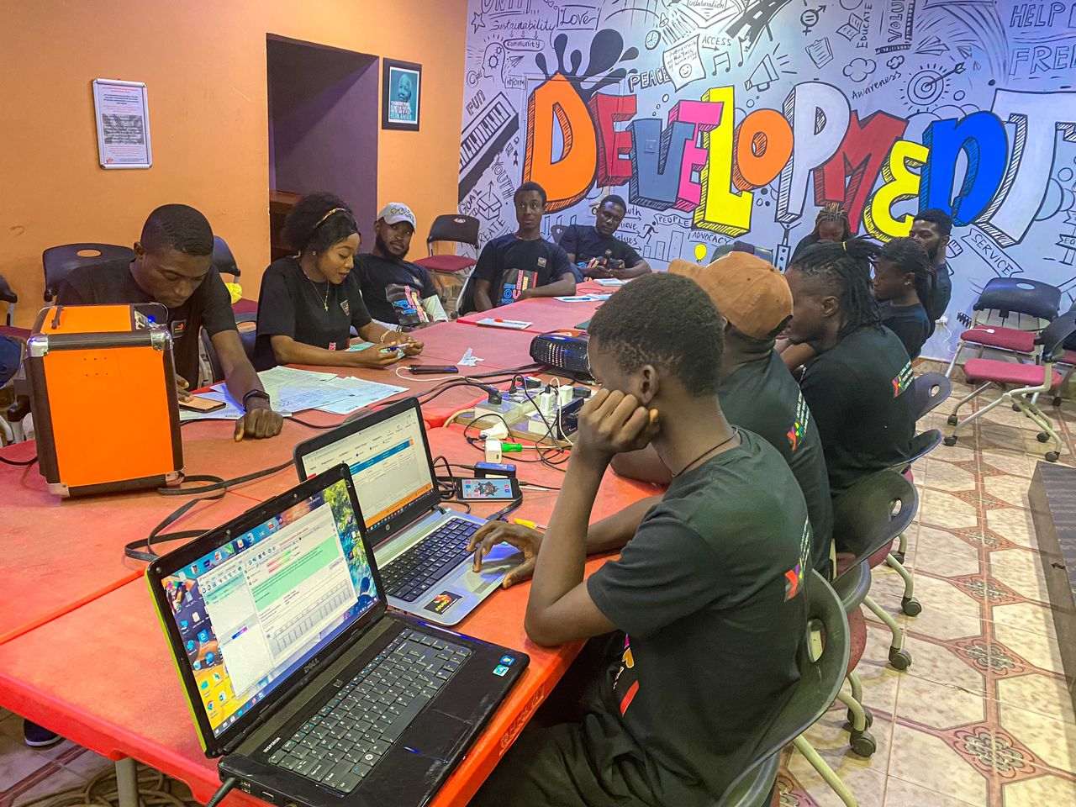
PICS: #AIDS2022 Conference Virtual Hub in Nigeria, funded by @Yplus_global implemented by @ANAYD_Africa.

Slide 21
Hosted the first of its kind Leadership Summit in Kaduna State Nigeria on the 14th-15th December 2018 and Second edition 18th-19th December 2019 at Icare multipurpose Hall Kaduna State, which brought participations UN Agencies Heads of Office, Government Agencies Heads, Development Partners Heads and Civil Society Organization Heads in full attendance and 150 Youth delegates whose capacities were built across: Leadership, Management, Resource mobilization, Politics, Governance, Mentorship, Life Skills (Goal Settings, Decision making, Assertiveness and Negotiation Skills)., Character Development, Entrepreneurship, Modeling and Fashion, Information Technology (IT), Health (Sexual Reproductive Health Education, HIV and Gender base Violence), Media Art and Entertainment.
Set up first of its kind Kaduna Volunteer Hub to help provide job and career development opportunities for young people and youth, the is an online Whatsapp plartform that provide direct link for AYPs with government policy makers (Legislatives, Judiciary and Executive), MDAs, UN Agencies, Development partners, International partners, Global Fund, CSOs and Media personnel. so far one young person on the platform was able to get an IT job in Kenya which he has resume work in Nairobi, other many got opportunities for conference participation in Lesotho, Morocco, Egypt and various many in Nigeria. More so one young lady in March 2020 got selected to join the first ever Global Fund Youth Council.
Collaborated with UNICEF Kaduna from 30th June to 2nd July 2020 to conduct a social media COVID-19 awareness and engagement campaign and giveaway for adolescents and youths in Nigeria towards promoting COVID-19 information and addressing misconceptions; Over 10000 young people got informed via social media and 3 young people with the highest likes and retweets won the context and got supported with 1000-naira data each.
Collaborated with EANNASO on 28th August 2020 to host Anglophone Countries Adolescents and Young People Constituency consultation for development of Next Global Fund Strategy which resulted to position statement and recommendation by AYPs for global fund to take up in its next strategy.
With partnership and support from NACA we engaged 15 young people in Abuja to review the National Prevention Plan (NPP) and developed a summarized version.
Engaged in the UNAIDS Strategy Development consultation to give youth perspectives as a youth network member of UNAIDS West and Central Africa Technical Advisory Group on regional Humanitarian issues.

Slide 22
Policy Coordination Platform for Adolescents and Young People (AYP)
Collaborating to host International AIDS and STI Conference in Africa (ICASA 2021) Youth pre-conference at Durban International Conference Center (DICC) 5th December 2021 Durban South Africa which will see 200 in persons participation.
Collaborated to host the 7th Adolescents and Young People Pre-Conference for Civil Society Accountability Forum 11th November 2021 Barcelona Hotel Abuja which saw participation of over 200 in persons across Nigeria with support from PEPFAR, EVA, AHF etc.
Co-led and collaborated to host the 1st African Regional Adolescents Health and Development Pre-Conference on 18th August 2021 in Army Resource Center Abuja which saw participation of over 200 in persons and 500 Virtually across Nigeria, Uganda, Kenya, South Africa, Ghana, Senegal, Liberia, Cameroon etc with support from UNAIDS WCA, UNESCO, PEPFAR, UNFPA, UNICEF, WHO, AHF etc.
Led and hosted West and Central Africa Youth Regional Consultation for UN High Level meeting on HIV/AIDS on 14th April 2021 with participation of over 118 youth networks across the region and support from UNAIDS WCA regional office, Education as a Vaccine (EVA) and Journalist Against AIDS (JAIDS). Priorities of youths were harmonized into a position statement and submitted for mainstreaming into the global civil society advocacy ask on 2021 political Declaration.

Slide 23
Projects Executed both Past and Current
Currently Implementing a USD 30,000 (22,963,500 Naira) grant supported by ISDAO for a 4 months (October 2023-January 2024). The Network initiative to improving key population friendly public healthcare service in Nigeria(#Inclusivehealth4all). The project is geared towards improving healthcare workers capacity to provide key population friendly service to adolescents and young people in their diversities in an integrated approach across 4 states namely (Anambra, Benue, Kaduna and Rivers).
Implemented a USD51,000 (23,500,000 Naira) grant supported by Elizabeth Glaser Pediatric AIDS Foundation (EGPAF) for 6 months (April -September 2023). The Social Networking Testing (SNT) Project is Strategy 1 under the ongoing AP3 Project which aims at reaching about 71,000 adolescents and young people in their diversities with HIV Testing Service across 9 Local Government Areas of 3 state namely (Benue, Lagos and Rivers state) in Nigeria.
Implemented a USD 6,400 (2,841,600) grant supported by Global Network of Young People Living with HIV (Y+) for 6 months (June-December 2023) Young Emerging Leaders Project in Nigeria.
Hosted PATA YOUTH SUMMIT 2022 Virtual Hub to support meaningful participation of 29 adolescents and young people in their diversities on 21st to 23rd November 2022 with 4800 USD (2,126,400) support from Global Network of Young People Living with HIV (Y+ Global).
Implemented 1 Month (1st-30th September 2022) Education Save Life Campaign with 3,614 USD (1, 572,090 funding support from UNESCO.
Implemented a 10,000USD (4,100,000 Naira) grant by International AIDS Society (IAS) for 12 months project (January 2022-December 2022). aim at achieving the Implementation of advocacy strategies to build and/or support HIV cure research in Nigeria, build advocacy networks and promote access to HIV cure education and information for clients, advocates and healthcare and healthcare providers in Lagos and Kaduna State Nigeria.

Slide 24
Implemented a 5,110USD (2,095,100 Naira) for a 6months (November 2021 -April 2022) “Social AID Fund Project 2.0" in Nigeria with funding support from Global Network of Young People Living with HIV (Y+) and UNIADS Global Office. The phase two project aim at conducting a situation analysis report on COVID-19 Economic IMPACT amongst adolescents and young people living with HIV and young key populations. Also providing support worth 600USD each for 6 persons 1 each from (AYPLHIV, YFSW, YPWID, AGYW, Young Positive Mothers and YLGBTQI) for economic empowerment through skill acquisition and providing them start up pack to start their business and put the skills into work across Nigeria namely (Abia, Anambra, Akwa Ibom, Kaduna, Oyo,and Taraba) the project commences November 2021 to April 2022.
Currently implementating a 12month (March 2021-February 2022) 100,000USD (38, 500,000 Naira) grant UNAIDS supported project in 3 Countries Nigeria, Senegal and Liberia, title: Strengthening Community Response on HIV for adolescents and young people in west and central Africa with ANAYD serving as the Implementing partner for Nigeria to work in Benue and Akwa Ibom States.
Implemented a 3months (July-September 2022) $6,288 (2,735,280) grant HIV Self Testing Demand Side Financing (DSF) For HIV Self-Testing Online Demand Side Financing. Currently, the project is at a phase of Demand Side Financing (DSF) for HIVST kit distribution towards achieving the Total Market Approach (TMA) to sustainability in Nigeria. ANAYD remains a key implementing partner with JHPIEGO on the extended STARIII #DSF4HIVST intervention in the four (4) coverage states which include: Akwa-Ibom, Lagos, Rivers and FCT Abuja.
Hosted AIDS2022 Conference Virtual Hub to support meaningful participation of 17 adolescents and young people in their diversities on 28th July-2nd August 2022 with 3000 USD (1,245,020) support from Global Network of Young People Living with HIV (Y+ Global).

Slide 25
Implemented a 7months (20th September 2021-30th March 2022) HIV Self Testing Project in Lagos State of 57,205USD (23,556,300 Naira) JHPIEGO grant aim at generating demand creation and HIV Self Testing Service uptake and optimization for a target of 30,0000 adolescents and young people in their diversities. A total of 18,500 persons were reached with HIVST information while 18,500 HIVSTK have been distributed to AYP and results reported comprising 8, 797 males and 9,703 females. A total of 159 reactive results were reported with 137 confirmed cases: confirmed positive males 42 and females 69, while confirmed negative males 15 and 11 females.
Implemented a 15months (April 2021-June 2022) research project of 72,532USD (27,562,160 Naira) grant UNAIDS HQ supported in partnership with Institution of public health Obafemi Awolowo University Ibadan. Title: Studying Social, Economic, and Health COVID-19 impact on adolescents’ girls and young women living with HIV. The research projects focus on reaching divers AGYWLHIV such as Female sex workers, migrants, refugees, Transgender, Living with disabilities in 6 states across 6 geopolitical zone of Nigeria with a total target of 480 for each 5 sub population groups and 2,400 in total.
Implemented Global Fund COVID-19 Response Mechanism (C19RM) Technical Assistant 12,000USD (4,560,000 Naira) Grant for Adolescents and Young People project; across 3 geopolitical zones and 3 states (Anambra, Rivers and Lagos States in Nigeria from April 2021 to June 2021. aim at promoting AYP knowledge of global fund and COVID-19 response mechanism, define priorities for adolescents and young people in their diversities in the C19RM process and Support AYPs meaningful involvement in priority setting and ensure priorities identified are mainstreamed into Nigeria COVID-19 Response Mechanism Grant Application. A total of95 persons (69 AYPs and 26 stakeholders) have been reached with knowledge C19RM, 12 AYPs empowered and supported to engage in C19RM Nigeria grant application for 2021-2023 process with their priorities captured.

Slide 26
Implemented Youth Rise COVID-19 Response Mechanism (C19RM) 5000USD (1,900,000 Naira) Grant for Consultation with Young People who inject and use drugs (YPWID)across 5 geopolitical zones and 6 states (Anambra, Akwa Ibom, Benue, FCT, Kaduna, and Lagos) States in Nigeria in May-June 2021. aim at promoting YPWIDs knowledge of global fund and COVID-19 response mechanism, define priorities for young people who inject drugs in the C19RM process and Support YPWIDs meaningful involvement in priority setting and ensure priorities identified are mainstreamed into Nigeria COVID-19 Response Mechanism Grant Application .A total of 20 YPWIDS have been reached with knowledge C19RM, 1YPWID empowered and supported to engage in C19RM Nigeria grant application for 2021-2023 process with their priorities captured.
Partnered with Society for Family Health (SFH) to implement a 3 months UNESCO Funded Spotlight Initiative project across 6states in Nigeria (Adamawa, Cross Rivers, Ebonyi, FCT, Lagos, Sokoto). The project aims at preventing Sexual and Gender Based Violence (SGBV) against adolescents’ girls and young women, the project is also design to strengthen the capacity of 90 youth networks and organization to carry out peer education and support young people (age 10-25 years) to access comprehensive sexuality education (CSE) and SRHR services the project commences April 2021 and will run till July 2021.
Partnered with Education as Vaccine (EVA) with funding support from UNFPA Nigeria to implement Community Engagement Project targeting 10 communities in 2 LGAs of Kaduna State. So far reached 50 community leaders, 23 law enforcement official responders, 10 CSOs from 10 communities with capacity on Sexual Gender Based Violence, (SGBV), and COVID-19 empowered the community leaders and sub granted to 10 CSOs organizations to reach over 2000 community members with sensitization on COVID-19, and Sexual Gender Based Violence (SGBV) and strengthen SGBV reporting with 9 cases reported the project commences December 2020 till date.

Slide 27
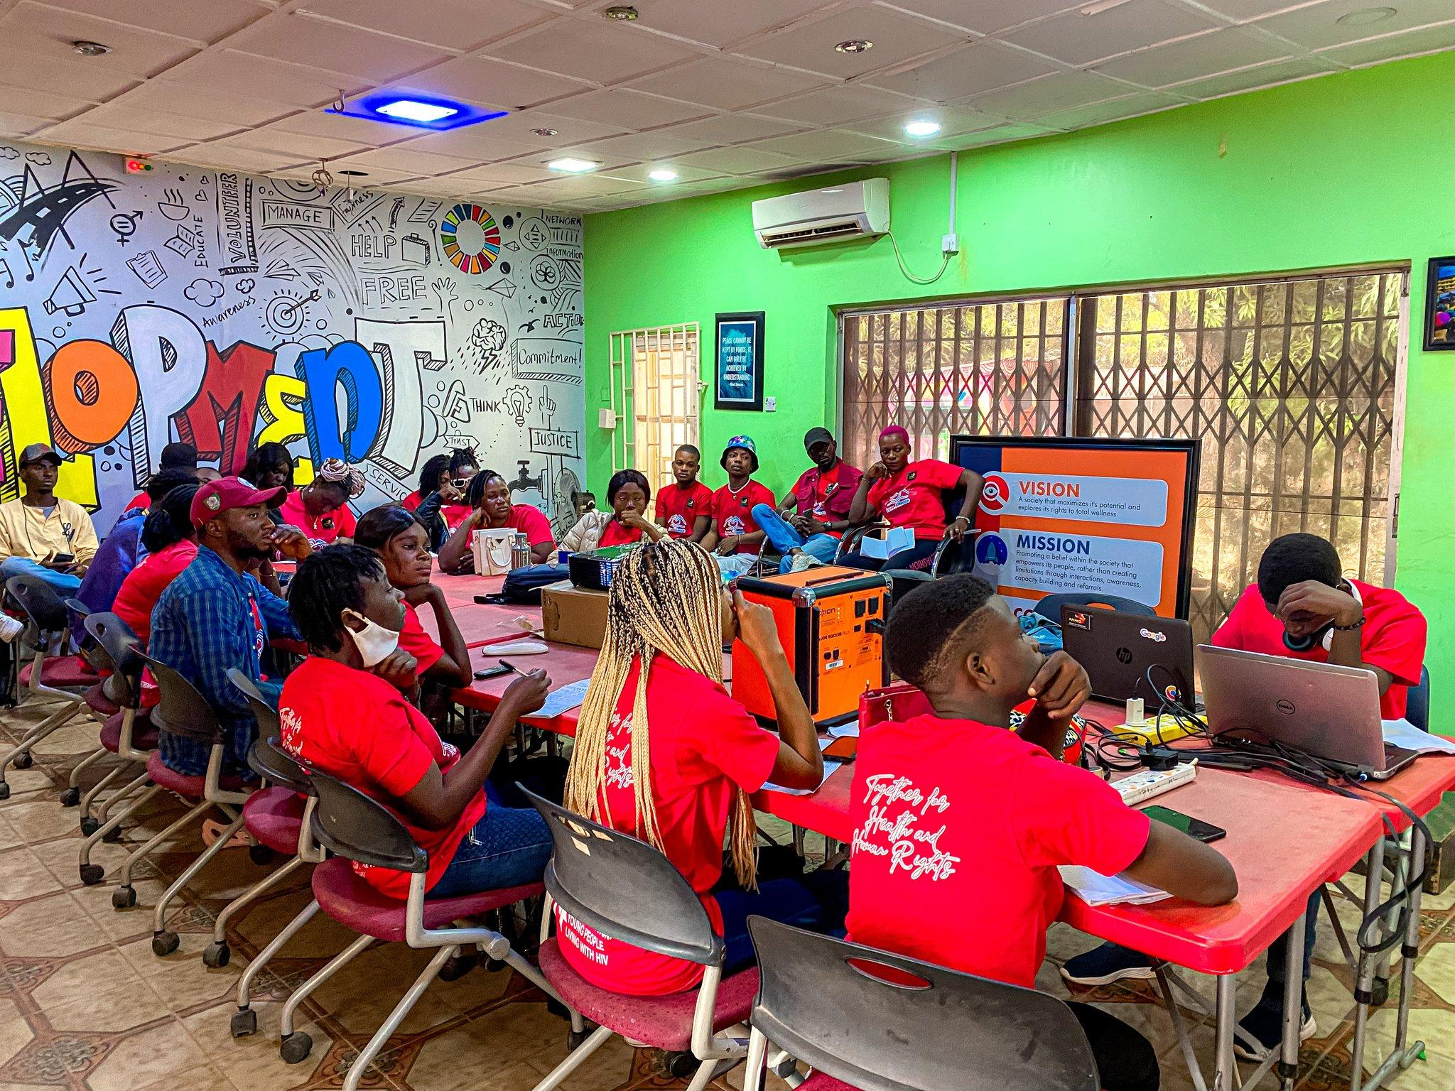
PICS: #PATA2022Summit from Kaduna State, Nigeria Country Hub with participants from KPs in their

Slide 28
Partnered with UNICEF for the implementation of #Adolescents Kits Intervention project in two pilot communities and LGAs of Kaduna State namely Igabi and Lere LGA which started August2020 till date. So far 4 young people have been trained as master trainers, conducted community stakeholder’s engagement, selected 24 community facilitators 6 each for two LGAs and recruited over 200 adolescents and young people 50 each from 4 communities, 2 communities per LGAs for roll out of twice a week and 8 times per month community circle session by community facilitators and AYPs.
Partnered with Global Network of Young People Living with HIV (Y+) with funding support from UNIADS Global Office to implement a 4,418USD (1,678,840 Naira) grant for “Social AID Fund Project" in Nigeria and so far, have developed a situation analysis report on COVID-19 IMPACT amongst adolescents and young people living with HIV and young key populations. Also providing support worth 44USD each for over 97 AYPLHIV and YKPs and YLGBTQI with COVID-19 support spanning across PPEs, Nutrition, School fees, Transport for ARV drug pick up, SRHR commodities like sanitary pads and moderate cash support for business across 13state in Nigeria namely (Abuja, Anambra, Akwa Ibom, Benue, Edo, Kano, Kaduna, Lagos, Oyo, Osun, Rivers, Sokoto, and Taraba) the project commence December 2020 to January 2021.
Partnered with Global Network of Young People Living with HIV (Y+) to implement National Consultation and case studies on mental health for AYPHIV in Nigeria. A project currently rolling in 3 countries Chile, Etwasini and Nigeria which starts October 2020 and ended December 2020.
Partnered with StrongEnoughGirls to implement AYP COVID-19 impact project which started September 2020 to November 2020 in 9 states with funding support from UNESCO. ANAYD covered 3 states namely Benue, Kaduna and Taraba and engaged 9 young people (3 each per state) as field volunteers who were train on use of ODK and deployed to engage community peers with interview.

Slide 29
Collaborated with EHRAAI Socio-Economic Tailoring Skill Empowerment project which commence 22nd September 2020 and will end 22nd December 2020. the project aims at training key and vulnerable groups living with HIV who were impacted negatively due to COVID-19 pandemic. 10 Adolescents and Young People living with HIV from ANAYD have been given free scholarship for the 4month tailoring training which afterwards a startup loan will be given to them to start their own business.
Implemented Global Fund Technical Assistant 50,000USD (17,500,000 Naira) Grant for Adolescents and Young People project; across 6 geopolitical zones and 6 states (Anambra, AkwaIbom, Lagos, Taraba, Benue and Kaduna) States in Nigeria from February 2020 to July 2020. aim at promoting AYP knowledge of global fund, engagement in Nigeria country dialogue and monitoring and evaluation of the implementation of Nigeria 2020-2022 grant circle. So far 150 adolescents and young people in their diversities have been reached with knowledge capacity on global fund in country structure, its operations and funding request process, 7 AYPs empowered and supported to engage for the first time throughout Nigeria global fund, funding request for 2020-2022 process with their priorities captured and country dialogue. Through social engagement with hashtag: #NG_AYPEngageGF generated impression of 116, 000 and reached 57,000 people via twitter.
Collaborated with Education as A Vaccine (EVA) on “2020 Rights, Evidence, Action (REA)” project 1st June to 30th July 2020. The project seeks to promote awareness and access of adolescents and young people to SRHR and LGBT rights, information, and services while increasing their capacity to engage the public, stakeholders, and policymakers, and influence policies to protect their SRHR and LGBT rights. 3 young people from ANAYD were trained and engage as advocates for the Project.

Slide 30
Coalition And Platform Membership
Member-Global Fund Board (The Executive Director is member of developing countries NGO delegation).
Member-Global Fund Advocate Network (The Executive Director is one of the Speaker Bureau for GFAN Global)
Member-Global HIV Prevention Coalition
Member- Global Fund Advocates Network for Africa (GFAN_Africa)
Member-UNAIDS Technical Advisory Group for West and Central Africa on Regional Humanitarian Issues.
Member-Civil Society Institute for West and Central Africa)
Member-The PACT Global
Partners-Global Network of Young People Living with HIV (Y+)
Member-African Youth Networks Coordination Platform (Hosting Organization)
Member-EANNASO Anglophone CRG platform
Member-African Health Advocates Platform.
Member-Global TB Network
Member-Universal Health CSOs Global Coalition (UHC2030)
Member-Global (National Coalition of Health Advocacy Funding).
Member-PEPFAR CSO PLATFORM Nigeria.
Member-Nigeria National Advocacy Network on UHC (NUCH)
Member-Nigeria National TB Network
Member-Coalition of Civil Society on Nutrition in Nigeria (CSSUN)
Member-Nigeria Reproductive Maternal New Born Child Adolescents and Elderly Health Plus Nutrition Multi-Stakeholders Partnership Coordination Platform (RMNCAEH+N)
Member-National Prevention, Treatment, Care and Support Technical Working Group
Member-National Adolescents and Young People Health and Development Technical Working Group Nigeria.
Member-Key Population Technical Working Group

Slide 31
Previous and Current Funders
ISDAO
Elizabeth Glazer Pediatric Foundation (EGPAF)
Johns Hopkins Program for International Education in Gynecology and Obstetrics (JHPEIGO)
Civil Society Institute for health in west and central Africa (CSIWCA)
Society for Family Heath in Nigeria (SFH)
United Nations Children Fund (UNICEF)
Kaduna State AIDS Control Agency (KADSACA)
United Nations Population Fund (UNFPA)
Center for Integrated Health Programs (CIHP)
Family Health International (FHi360)
Association of Reproductive Family Health (ARFH)
AIDFOUNDATION
UNAIDS HQ
International AIDS Society (IAS)
Global Fund to Fight AIDS, Tuberculosis and Malaria
Global Network of Young People living with HIV (Y+ Global)
Education as A Vaccine (EVA)

Slide 32

THANK YOU

